Slide 1


A presentation

Slide 2
Overview
Who We Are
Vision, Mission & Core Values
Independent Consultants Experience
Professional Services
SNAPSHOTS
Company Strengths
Benefits to Your Company/ NGO/Non-Profit
Costing

Slide 3
Who We Are…

Slide 4
About Our Company
We are A Professional Team of Independent Consultants who provide our clients with Expert Training, ICT & Project Management Solutions.

Slide 5
Quality Experience You
Can Depend On…
50 yrs experience in workshop facilitation, training and project management.
10 yrs experience in HSE (including First Aid).
15 yrs experience in ICT solutions.
10 yrs experience in Conflict Resource Management.
Client Servicing – reliable, pleasant consultancy that allows open communication.
Honesty & Integrity in our work ethic.

Slide 6


Vision.
“Optimizing Business Solutions & Marketing Strategies to Advance Global International Environments.”

Slide 7

Mission.
OPTIMAL.
OPTIMUM.
OPTIMIZED.

Slide 8

Core Values.
LOVE OF LIFE
ENERGY FLOW
COOPERATION & TEAMWORK
WIN/WIN

Slide 9
Independent Consultants
Experience/Certifications
Our cadre of Independent Consultants have training in Conferencing, HSE, Coaching & Mentoring, Document Management, Customer Service Training, Project Management, Management Information Systems, MCSE, MCP, MOS, WRMT, ICT Solutions, Community Support Services, Environmental Sciences and HR Services.

Slide 10
PROFESSIONAL SERVICES

Slide 11

Services Provided
PROJECT MANAGEMENT & HR SERVICES.
TRAINING SOLUTIONS
DOCUMENT MANAGEMENT
ICT SOLUTIONS

Slide 12
Services Provided
PROJECT MANAGEMENT & HR SERVICES
Eltra Opulent Project Advancement Resource Kit
Your university’s vision, profits and marketability matter to us. We provide you with a range of resource tools and materials that will greatly assist in the successful implementation of your desired business solution.
Human Resource Audits
We provide customized HRAs that may assist in helping your organization improve employee-employer relations & boost company morale.

Slide 13
Other Notable NGO Partners who have benefited from our Consultancy Experience.
Writers Union of Trinidad and Tobago (WUTT)
Junior Environmentalists of Trinidad & Tobago (JETT)
Trinidad Youth Council (TYC)- (Also Electoral Support)
Several NGOs volunteering capacity:
-Network of NGOs. Project Coordination of Women At Work Photography Competition & Assisting with several projects including MDGs Millennium Forum.
-Institute for Future Global Leaders (IFGL) working alongside the UWI Guild of Students.

Slide 14
Services Provided
TRAIN THE TRAINER EXCELERATION PROGRAMMES
Coaching & Mentoring Services
TRAINING SOLUTIONS
TRAIN THE TRAINER EXCELERATION PROGRAMMES
Coaching & Mentoring Services
Develop Leadership at All Levels
within Your Organization’s Hierarchy
More than just an organizational structure, your company has real people who have behaviors which can positively affect your organization’s capacity to excel.
Determining Your Organization's
Context for Training
Aspects of Eltra Opulent Associate’s Training Opportunities & Needs Analysis
Your employees, staff, trainees will therefore benefit from our experts who implement customized personal supportive training systems.

Slide 15
Services Provided
CONFERENCING & DOCUMENT MANAGEMENT SERVICES
Eltra Opulent Associates Ltd. has a wide range of document drafting services that extends to Proposal Drafting Services, as well as customized DMS Solutions for your conferences, offices and employees to avoid costly loss of data & data redundancy.
Prevent Frustrated Work Experiences. Avoid Employee Burn Out…through our Conferencing Management & Support Services.
We provide you, with a progressively sane approach to managing your data resource needs.
Though our MIS & ICT experts will assist in data recovery, our motto is simple: “ Avoid Data Collapse”.

Slide 16
Services Provided
ICT SOLUTIONS
BENEFITS OF ICT SOLUTION PACKAGE
Eltra Opulent’s Information Communications Technology Solutions provide our clients with the capacity to store, retrieve and effectively access company data.
Creation of Virtual Networks, software platforms & e-commerce solutions which provide real-time flow of information anywhere around the world.

Slide 17
SNAPSHOT

Slide 18


NYCTT TASKFORCE, INNER CAUCUS OF
DECISION-MAKERS RESPONSIBLE FOR :
Chair of Constitution Committee. Project Administration, Proposal Financing, Assisted in Coordination of Committees & Negotiation Caucus, Coordination of Constitution Meetings, Constitution Retreat & Final Drafting of Constitution. AS WELL AS OVERALL DOCUMENTALIST VIA STRUCTURING OF PROPOSALS FOR FINANCING FOR EACH COMMITTEES; 10 YRS INTERACTION WITH MSYA, IN YOUTH DEVELOPMENT PROJECTS & WORKSHOP FACILITATION.
INTERGENERATIONAL HERITAGE GAMES (IHG) PROJECT: Traditional Games in Communities (a national project). EVERYBODY MATTERS (EBM) – Healthy Lifestyle Choices for Young Women, modified to include Young men as well. SPORTS MEDICINE CONFERENCE – Sports administration for Professionals. SPORT & HIV AWARENESS FOR ATHLETES, COACHES & ADMINISTRATORS. Main Consultancy Work: Project Administration, Proposal Drafting, PowerPoint Presentations, Evaluation Instruments, Reports, Publications, Coordination of Stakeholder Meetings, Interviews, Branding (e.g Banner, Logo designs), etc.

Slide 19

COMMONWEALTH PAVILION OF THE PEOPLE’S SPACE 2009 : CHOGM “Commonwealth History, Art & Diversity Appreciation” Proposal (Financing).
TALK ANANSI PARENTING SUPPORT – TAPS PROJECT 2009 Proposal (Financing).
MANNERS MATTER (M2) 2008: Morals, Values Education for students (pre-schoolers, primary&secondary) – EDUCATION CARAVAN. Project Administration, Proposal Financing, Coordination of Marketing & Media Communications & Branding for Project, Including Publications, Development of Evaluation Instruments & Final Report.
NOVEMBER’S CHILDREN SHOW 2008: Interactive Storytelling Children’s Show (UWI). Project Administration, Proposal Financing, Coordination of Marketing & Media Communications & Branding for Project, Including Publications, Development of Evaluation Instruments & Final Report.
TASU
Talk Anansi Story Unit
STORYTELLING FOR EARLY CHILDHOOD PARENTING SUPPORT (S.T.E.P.S.): Introduction of Early Childhood Storytelling to Caregivers and Administrators in Belize, Dominica, Guyana, Suriname and Trinidad & Tobago. Project administration provided, coordination of media interviews, branding, Reports and PowerPoint Presentations & BVLF Final Publication.

Slide 20

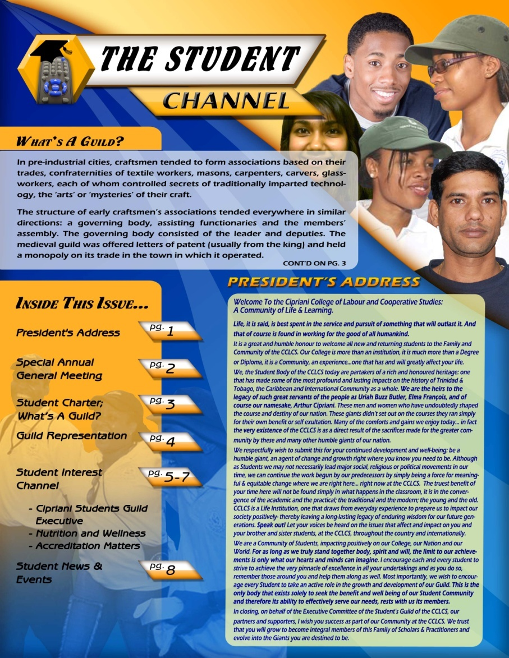
CIPRIANI COLLEGE OF LABOUR & CO-OPERATIVE STUDIES STUDENTS GUILD (CCLCSS)
Consultancy Provided on Coordination of Student Orientation including for design mock-up of Student Guild Newsletter, Printing of Publications, Electoral Consultancy Support Services.

Slide 21
COMPANY STRENGTHS

Slide 22
Company Strengths
A Qualified Team of Independent Consultants.
Customized Solutions for Your Business/Organization.
Cost Benefit Analysis & Risk Management Services to Minimize Costly Project Overruns, as part of our Win/Win Philosophy.
Ensuring Your Conferencing Objective Needs Are Met.
Professional & Reliable Delivery of Consultancy Services for our Clients.
Our ICT capacity includes networking, web conferencing, teleconferencing, software security and data management.
A blend model of these components will ensure that your project or business solution is successfully executed.

Slide 23
CLIENT BENEFITS

Slide 24
Client Benefit Summary
Quality, Friendly & Efficient Consultancy Services.
Highly Experienced team of Professionals Consultants who can innovatively address, train and provide expert advice for your company’s needs.
Customized Resource Materials and Projects.
Use of Advanced ICT Solutions.
Reducing the Risk of Ineffectual Time Management & Loss of Valuable Manpower Hours.
Inevitable Success for Your Conferencing, Training & Project Management Needs.

Slide 25
Client Billing Options

Slide 26

We offer our clients, both long-term & ad-hoc the following billing options:
Variable Rate Packages & Fixed Rate Packages

Slide 27

We Will Help You On Your Path To Success as you move from strength to strength.

Slide 28
OUR ELTRA OPULENT
FIVE-STAR GUARANTEE:
  REAL-TIME ACCESS TO PROFESSIONAL SERVICES
  HIGH QUALITY IN THE CREATION & DELIVERY OF CUSTOMISED SOLUTIONS THAT CAN BE EVALUATED & MONITORED.
  AFFORDABLE & COMPETITIVE RATES IN THE INDUSTRY
  MUTUALLY BENEFICIAL PARTNERSHIP THAT ENSURES YOU ACHIEVE YOUR ORGANISATION’S GOALS.
YOU’LL HAVE OUR UNDIVIDED ATTENTION.

Slide 29
What Happens Next…
Questions we will need to know:
What are your present institutional needs?
What projects and/or specific targets are you focusing on presently or in the immediate future?
What time constraints, if any exist?
Who are the persons we will require to interface with to assist in consultancy?
What are your budgetary needs for any of our services?
Are there any mentionable institutional policies which may assist/detract from achieving your desired goals?

Slide 30
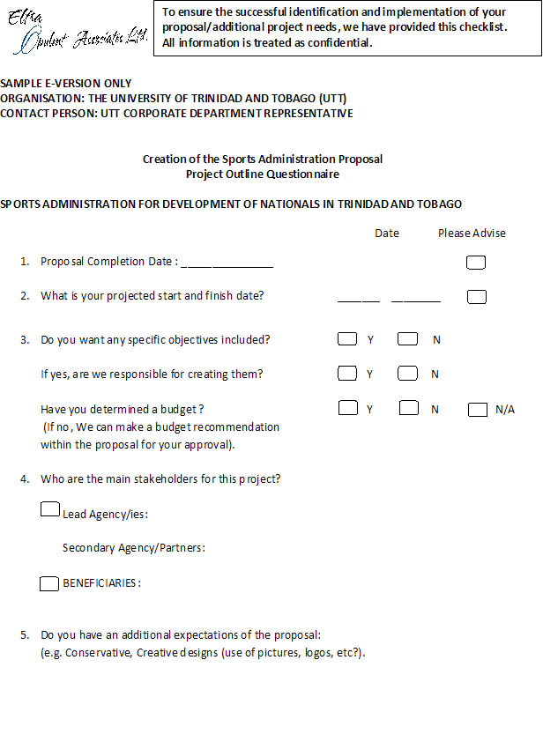
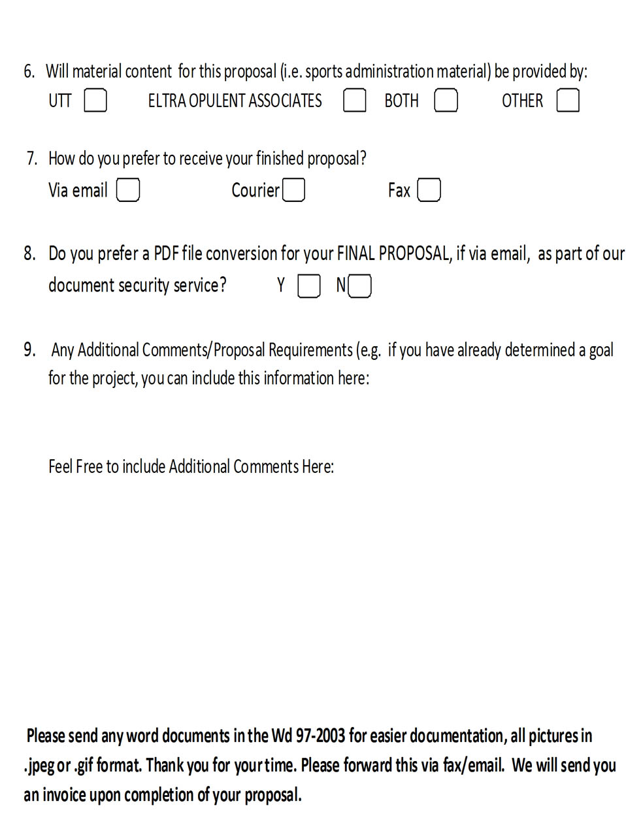

Slide 31
Any Questions For Us?
T H A N K Y O U.
© 2010 Eltra Opulent Associates Ltd. All Rights Reserved.

